Slide 1


SALES REPORT
FOR DTLM RETAIL
JANUARY – MAY 2020
PRESENTED BY:
DANIEL CHUKWUMA
APRIL 30, 2023

Slide 2

CONTENTS
01
Overview
02
Revenue Trend
03
Top 5 Products by Revenue
04
Top 10 Sales Team by Revenue
05
Conclusion & Recommendation

Slide 3



OVERVIEW
This report aims to review the company’s financial performance from January to May 2020. Data was analyzed to obtain revenue and profits, as well as sales performance of products and team members.
The analysis of this report was achieved using Microsoft Excel. Various computations were made to arrive at key business metrics to drive decision making.
Key metrics presented in this report include revenue trend, top 5 products by revenue, and top 10 sales team by revenue.

Slide 4
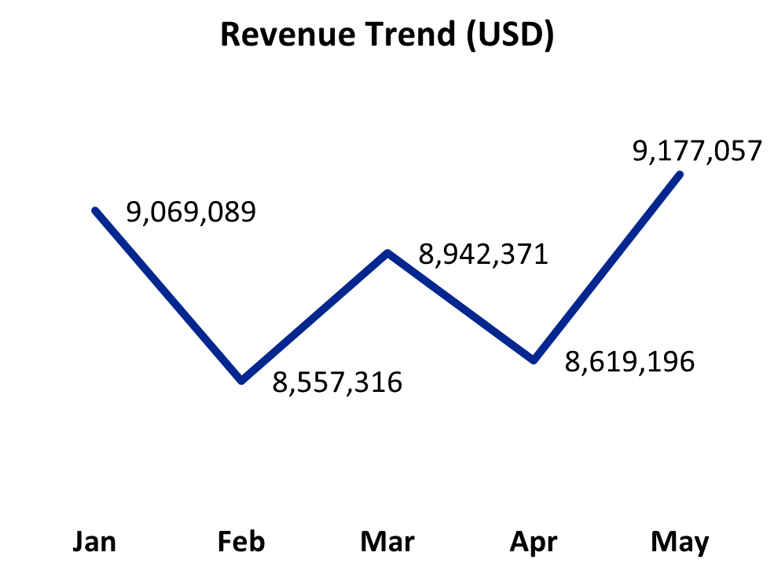
REVENUE TREND
A total revenue of 44.3 million USD was achieved within the 5-month period.
February had the lowest revenue of 8.5 million USD, while May the highest revenue of 9.1 million USD.

Slide 5
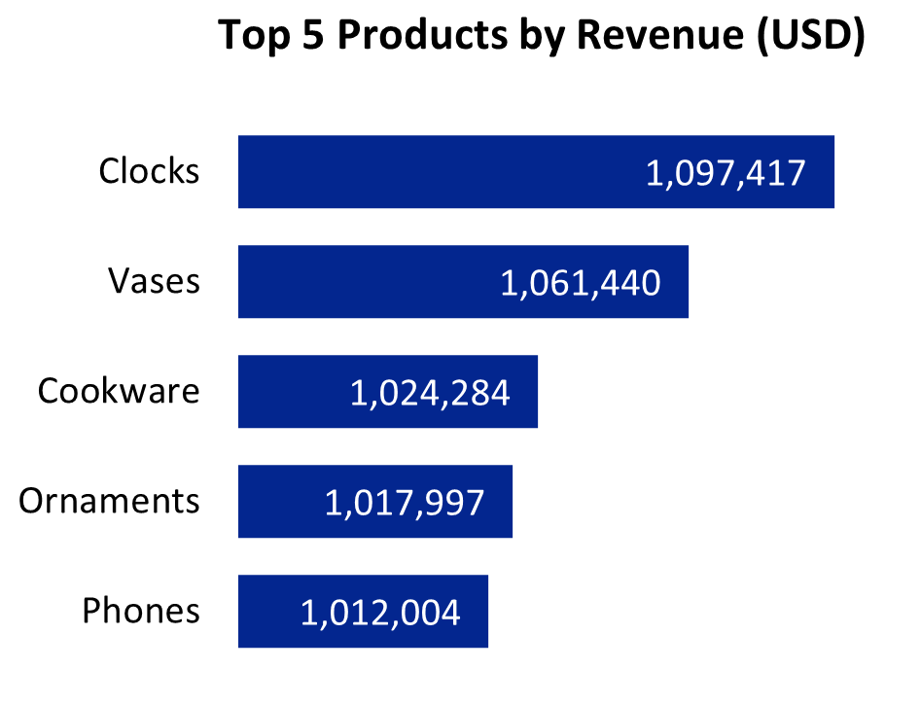
TOP 5 PRODUCTS BY REVENUE
There were 47 products which were sub-divided into 10 categories like Accessories, Beddings, Collections, etc.
Clocks, Vases, Cookware, Ornaments, and Phones were the top 5 products by revenue amounting to 12% of the total revenue.

Slide 6
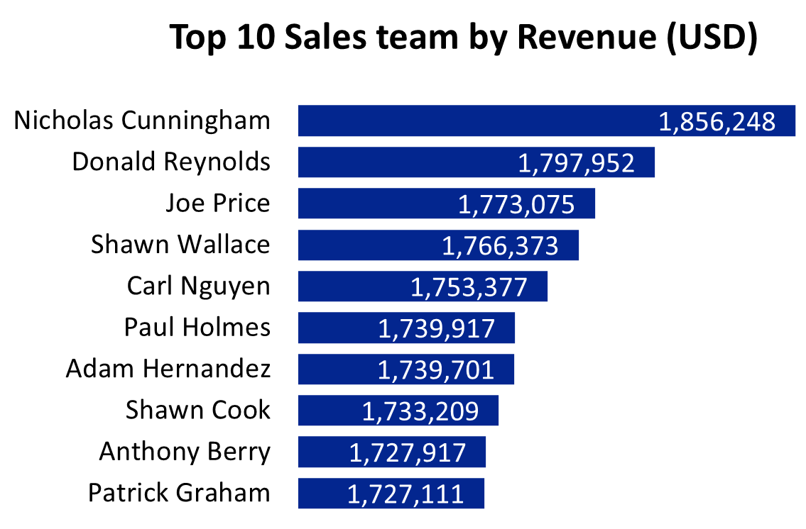
TOP 10 SALES TEAM BY REVENUE
Out of 28 persons in the Sales team, these 10 people achieved the highest revenue.
Total revenue from this top 10 amounts to 17.6 million USD, which is over 40% of the total revenue from all sales.

Slide 7

CONCLUSION
A total revenue of 44.3 million USD was achieved within the 5-month period.
There were 47 products which were sub-divided into 10 categories like Accessories, Beddings, Collections, etc.

Slide 8


RECOMMENDATION
Discounts and Promos could be run on seasons like Valentine, Easter, etc. to get more revenue from sales.
There should be rewards for top performing salespersons to motivate the team.
More marketing campaigns should be carried out on low performing products.

Slide 9
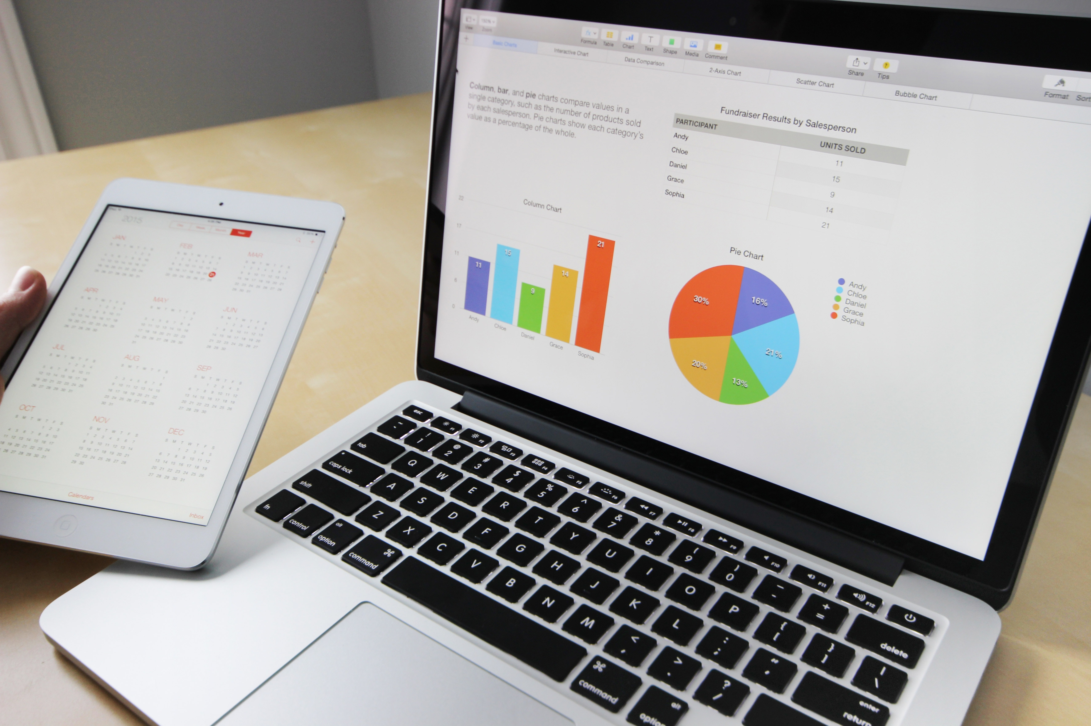
THANK
YOU

